Slide 1
Ridgeway Elementary Individually Guided Education

Slide 2
Ridgeway History
School opened in 1923
Dr. O.V. Wheeler proposed that Ridgeway become a magnet school in 1972
Ridgeway adopted the Philosophy of Individually Guided Education.
Ridgeway has remained a magnet school following the IGE philosophy since that time.

Slide 3
The IGE Philosophy
The IGE philosophy is founded on the idea that “success leads to success” and that students are unique individuals.

Slide 4
Belief Statements
We believe that successful learning experiences build successful learners.
Parent Involvement encourages and nurtures student learning.
Children learn best in environments that utilize multiage and flexible groupings.
Children benefit from being part of a learning community and develop relationships with a variety of teachers.
Teachers need to have opportunities to learn and collaborate.

Slide 5
Ridgeway Mission Statement
The mission of Ridgeway IGE School is to help each student become a self-directed, self motivated, life-long learner, capable of meeting the challenges faced in a life-time.

Slide 6
What is IGE?
Individually
Students are grouped into multi-age classrooms.
Guided
Teachers and students work together towards learning goals.
Education
Students learn at a pace that is appropriate for them.

Slide 7
The Heart of IGE

Slide 8
Multi-Unit Organization

Slide 9
Instructional Programming for the Individual Student
Ridgeway has developed its own procedure for reporting progress to parents.
Teachers use district materials and supplement for individual students.
Key focus areas are identified and worked on throughout the school.

Slide 10
Magnet School Open to All Columbia Students
Lottery System
Family Inclusive
Stable Population
Outreach
Transportation Provided Throughout the District

Slide 11
Accountability
Ridgeway will be accountable to all stake holders (Students, Parents, Community Teachers) for student performance using state grade level expectations and district curriculum objectives
Student performance will be measured using ongoing formal and informal assessments, including state mandated tests.

Slide 12
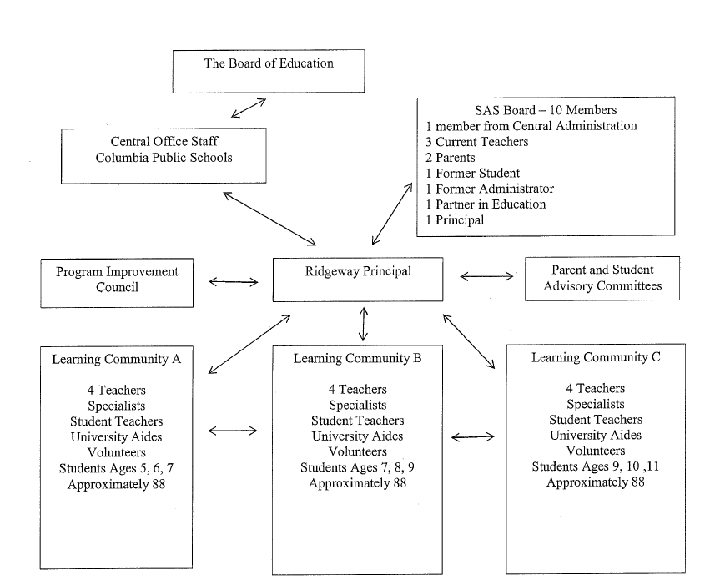
Structure and Governance

Slide 13
District-School Relationship
CPS and Ridgeway Elementary

Slide 14
Curriculum, Instructional Materials, and Assessment
Ridgeway will follow the state and district curriculum
Instructional programming for individual students, including thematic instruction, which is student focused, not grade level focused
Alternate materials and assessments may be selected to better meet the needs of Ridgeway students

Slide 15
Financing and Budget
District CFO will provide leadership in developing and allocating district
funds.
Ridgeway would retain cost saving dollars for Ridgeway use
Retain money from one year to the next in order to make fiscally responsible decisions

Slide 16
Facilities
As Columbia school, the primary responsibility of maintaining the building remains the responsibility of the school district. The SAS will seek funding from alternative sources when possible to supliment district maintenance.

Slide 17
Schedules
The Ridgeway community would retain control over adjusting or adapting schedules to meet the needs of the learning community. The community will continue to meet mandated guidelines, while looking for was to make adjustments that benefit the school.

Slide 18
Technology Resources
CPS will continue to maintain a computer lab, classrooms computers and other essential technology commensurate with other schools in the district.
The school will work towards the use of innovative technology, including iPads.
The school will maintain a focus on technology appropriate to student learning needs.
Continued professional development to support new technology learning and application

Slide 19
Grants and Alternate Funding
PTSA has developed a grant writing coordinator position.
This year $4000.00 has been generated through grants.
Teachers, Units, and Administrators will continue to look for funding through grants.
Seek help through our Business Partners.
Explore the Possibility of a Ridgeway Foundation funding

Slide 20
Professional Development
Developed a Partnership with Columbia College
Professional Development School Model
Continue participation in CPS professional development that meets the needs of IGE
Team-focused to provide differentiated instruction

